Slide 1
Secure Your powershell profile
Please. For God’s sake. Secure your damn profile
Notes:
I am kind of obsessed with Best Practice
Although, when I think about it… it’s probably more accurate to say I’m fascinated – absolutely fascinated – by worst practice. Worst practice is EASY. It’s tempting. It’s SIN and it’s delicious. This will become clear as we go on. Anyway, If you’re anything like me (and I hope you’re absolutely not) then you rely on your PowerShell or bash profile for a lot of things. You might have scraps of functions in there, you might have modules you load at the start of every session, you might have reminders that pop on screen when you start a shell and, most significantly, you possibly have an absolute ton of API keys and Secrets that were they to escape, could wreak havoc.
Hi, I’m Jason Brown (intro)

Slide 2
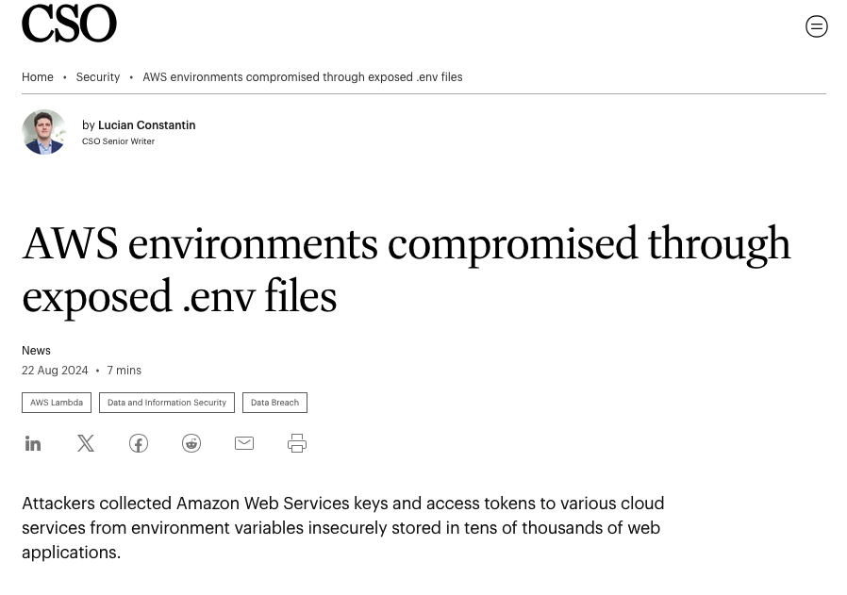
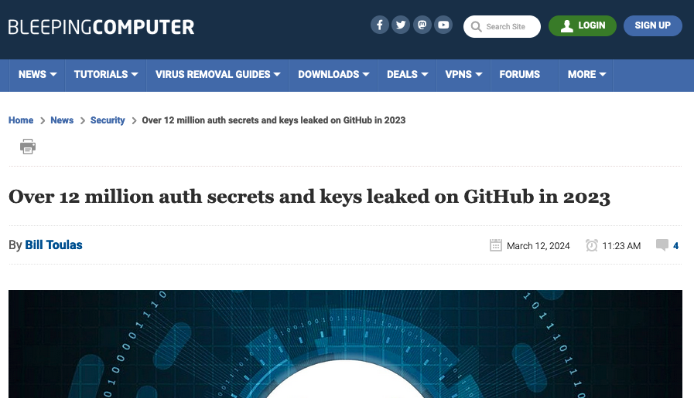
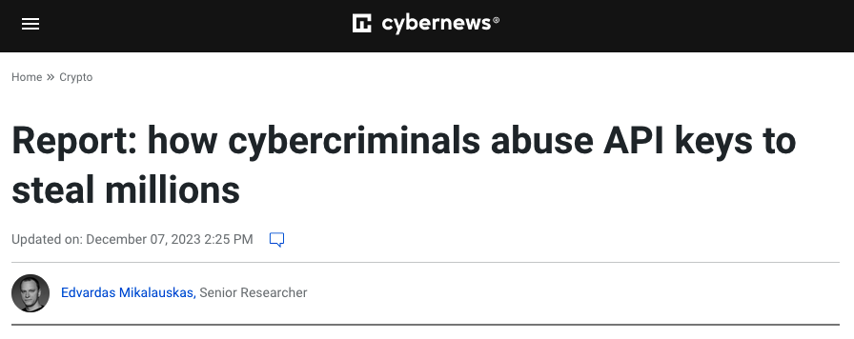
Notes:
The most well-publicized way to leak an API key is Github. We’ve all heard stories of Bill Shock from someone leaking AWS credentials, then a hacker popping into their account and racking up tens of thousands of dollars in usage fees. They’re nice and headline grabbing. But there are lots of more subtle ways a leaked API or Application key can make your life miserable. So it’s pretty important to protect them, right? But here we are, us powershell folks, probably with a ton of secrets sitting in our PS Profiles in plain text on a hard-drive
Is this really a problem? Well, so far I haven’t been able to find specific examples of large-scale hacks exploiting this very specific pathway, but I have definitely found discussions about secrets being harvested from .env files in running applications, and plenty of discussions about profiles and .bashrc files as potential vectors. I have no doubt, based on experience, that PowerShell profiles HAVE been exploited on a small scale for mischief. I’ve PERSONALLY seen office pranks executed via Powershell profiles so I would NOT be surprised AT ALL to see this being exploited in some way
Besides, it’s just generally good practice not to leave potentially sensitive data sitting in rest in plain just ready for some bit of malware to harvest. And yeah, sure your hard drive is encrypted. That absolutely wouldn’t stop, say, a malicious PowerShell module you happen to have found from lifting your profile - from its known location - and sending it off to a Pastebin somewhere for exploitation. So what can we do about this? Well… what do you do with your passwords? You’ve got them in a password manager, right? RIGHT?
https://www.techradar.com/pro/this-new-keylogger-uses-microsoft-powershell-scripts-to-quietly-steal-sensitive-information-here-s-how-to-protect-your-data
https://www.csoonline.com/article/3488207/aws-environments-compromised-through-exposed-env-files.html
https://cybernews.com/security/report-how-cybercriminals-abuse-api-keys-to-steal-millions/
https://www.bleepingcomputer.com/news/security/over-12-million-auth-secrets-and-keys-leaked-on-github-in-2023/ https://www.csoonline.com/article/3488207/aws-environments-compromised-through-exposed-env-files.html
https://www.techradar.com/pro/security/exposed-aws-credentials-stolen-within-minutes-by-github-hackers

Slide 3
Let’s get some prerequisites out of the way
Demo is in a Virtual Machine
I’m using fake data
I’m using powershell core in the standard terminal
I have starship installed with some nerdfonts for readability
The dashlane cli is installed but not configured
Notes:
I personally use Dashlane for all my own passwords but the technique I’m going to show you here will work for 1Password, LastPass, BitWarden, in fact any password manager with a Command Line Interface. This video is not sponsored, it just happens to be the Password Manager I use at home It will also work (and scale) with cloud-based secret managers like you’d find in AWS, Azure, Google Cloud and it should also work with Hashicorp Vault and similar apps, but I’m going to focus down at the personal level for this particular video. And I’ll be doing it in a fresh virtual machine with fake secrets. Just for you. You can play along, if you like. Now, first things first, let’s define the environment I’m demoing this in. I’m in a Virtual Machine running MacOS I’m using Dashlane Free I’m using PowerShell Core, running under the standard terminal I have starship installed The CLI is installed – you can find the docs at https://cli.dashlane.com (not sponsored!) – but not configured You’ll also need PowerShell-Yaml if you want to use my example code, but you can use the built-in JSON parser if you’re OK with that. https://github.com/gitleaks/gitleaks

